Slide 1
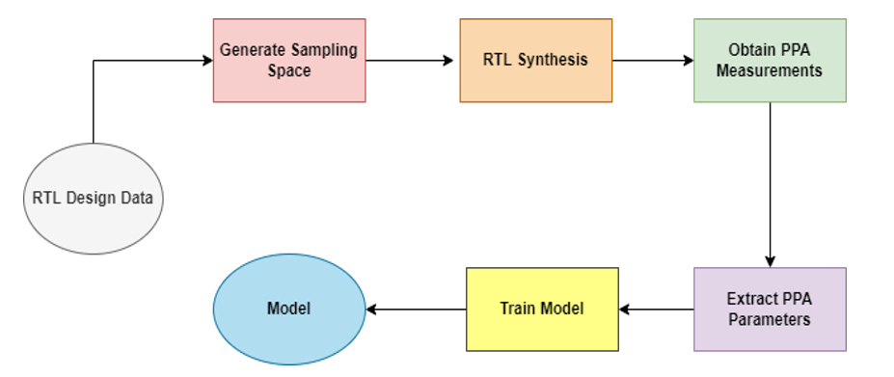
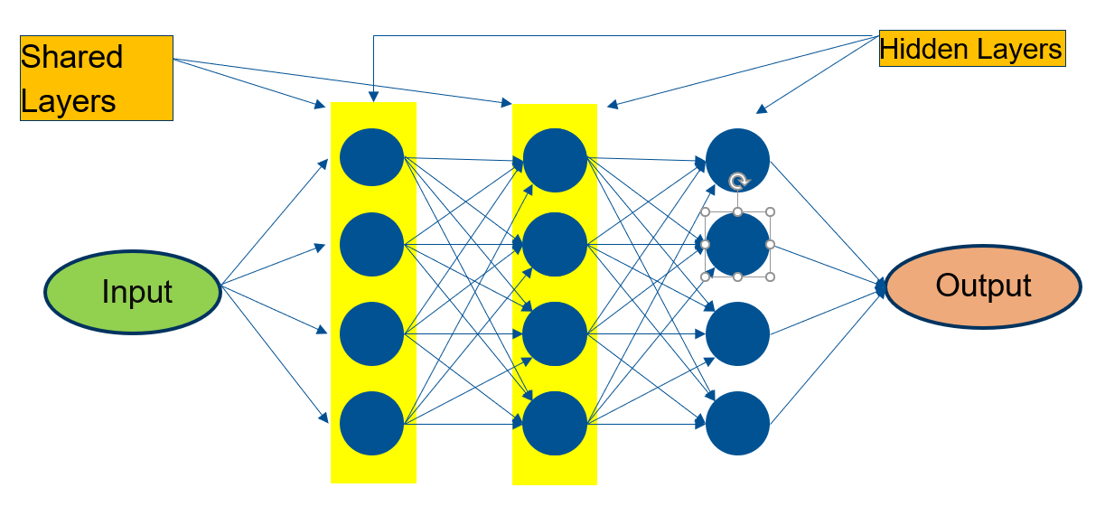
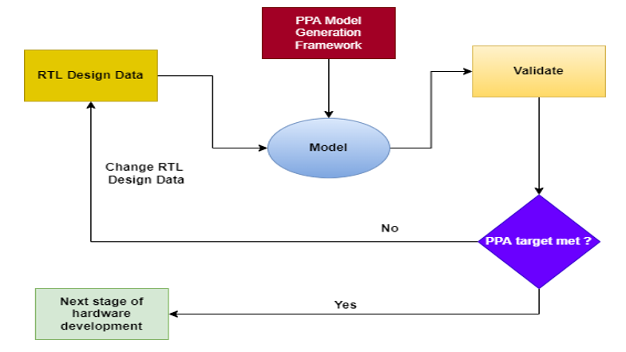
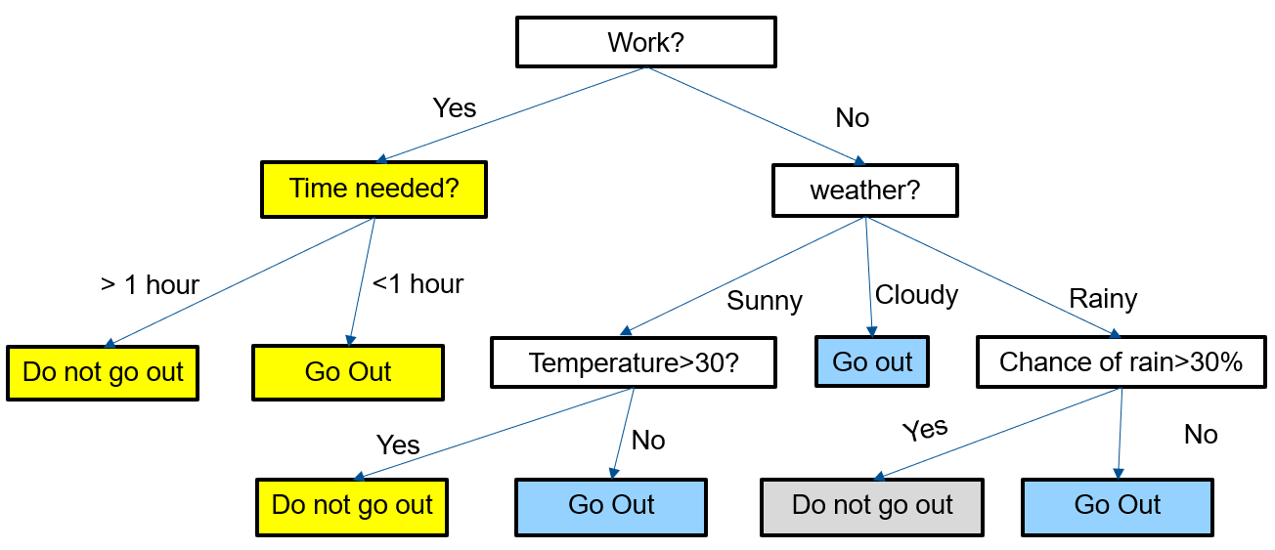
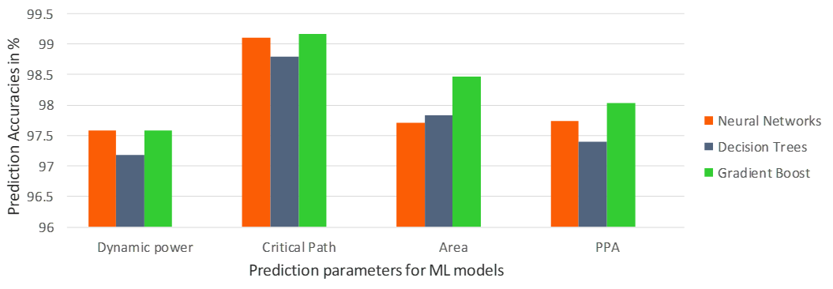
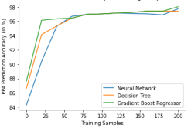
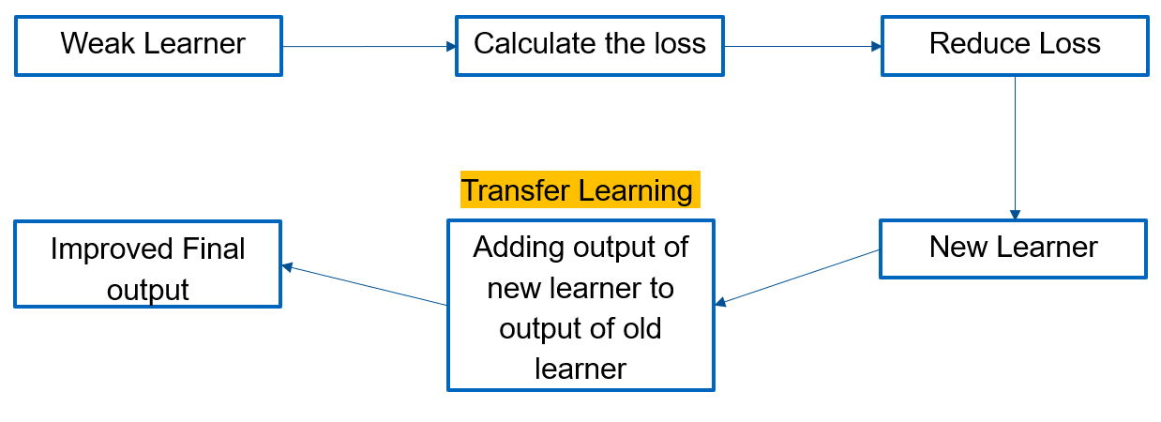
Fast and Accurate PPA Modelling Using Transfer Learning
Abhishek Sengupta
Chair of Electronic Design Automation
Technische Universität München
Introduction
Machine Learning(ML) models: lot of data and high training time
Transfer Learning: knowledge sharing, less data, less training time, higher accuracy
PPA Model
PPA Model Generation Framework
PPA Model Testing Framework
Neural Networks
Shared layers for Transfer Learning
Decision Trees
New branches added to base model
Gradient Boost Regressor
Combination of weak learners
[1]
[1]
Results
PPA Prediction accuracies
Accuracy vs training samples
[2]
[1]
Reference
[1] W. R. Davis, P. Franzon, L. Francisco, B. Huggins and R. Jain, ”Fast and Accurate PPA Modeling with Transfer Learning,” 2021 IEEE/ACM International Conference On Computer Aided Design (ICCAD), 2021, pp. 1-8, doi: 10.1109/ICCAD51958.2021.9643533
[2] J. w. Lee and C. Giraud-Carrier, ”Transfer Learning in Decision Trees,” 2007 International Joint Conference on Neural Networks, 2007, pp. 726- 731, doi: 10.1109/IJCNN.2007.4371047.
[1]

